Slide 1
Slack account sign in from a new browser
Test data test data
After finishing above priorities, team members have performed Ad-hoc testing for Browser extension (Canary).
(edited)
After finishing above priorities, team members have performed Ad-hoc testing for Browser extension (Canary).
(edited)
After finishing above priorities, team members have performed Ad-hoc testing for Browser extension (Canary).
(edited)
After finishing above priorities, team members have performed Ad-hoc testing for Browser extension (Canary).
(edited)

Slide 2


Slide 3

Margaret Atwood Won’t Leave Gilead Just Yet

Slide 4






Slide 5


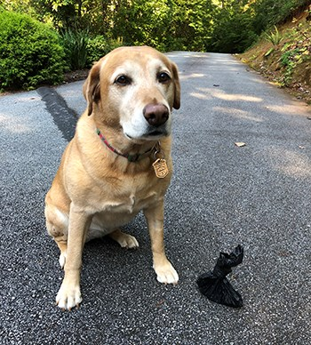

Slide 6


